Slide 1
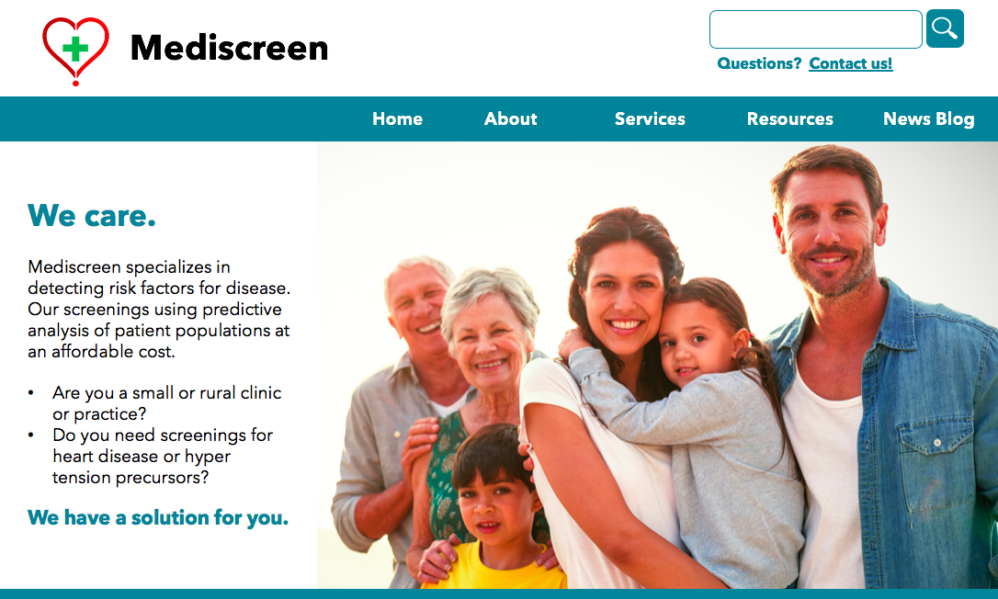
Project 9
Develop a Complete Application For Your Client Using Agile Techniques

Slide 2
Summary
Objective of the project
Problem to be solved
Solution
The technical stack of this application
Requirements/Features
Sprint 1
SureFire Report (patient-service)
Jacoco Coverage Report (patient-service)
Requirements/Features
Sprint 2
SureFire Report (history-service)
Jacoco Coverage Report (history-service)
Requirements/Features
Sprint 3
SureFire Report (report-service)
Jacoco Coverage Report (report-service)
SureFire Report (ui-service)
Jacoco Coverage Report (ui-service)

Slide 3
The main goal of the project is to develop an application to help physicians predict diabetes based on their notes.
Problem to be solved: Many patients suffer due to poor nutritional choices. They often select cheaper, high-sugar, and caloric foods instead of a balanced diet, including vegetables. Because of this, they are more susceptible to certain illnesses and diseases, such as type 2 diabetes. The the project is mainly focused on preventive care, that is, to help doctors identify patients at risk.
Solution:
Develop an app with a user interface where the patient will be entered into the database with all the necessary information.
The physician will be able to leave notes after each patient visit.
Based on the analysis of all the records made by the physician, the application will help to conclude what stage the patient is at.

Slide 4
The technical stack of this application
Back-end logic
Java
Spring Boot Framework
Maven
Thymeleaf
Database management system
MySQL
Mongo NoSQL
Front-end design
HTML
CSS
JavaScript
Boostrap
Deployment
Docker

Slide 5
Requirements/Features
Sprint 1.
The main goal of this sprint is to get some infrastructure in place that will leverage throughout, namely, to begin the process of creating Docker microservices. Create patient-service. This microservice should be a REST implementation for accessing the patient's personal information and working with it. The code should be linked with the SQL database and get them to talk to each other. Use initial information about users to populate and test data implementation. Make sure the finished microservice is deployable in Docker. Create the REST API documentation for the current microservice.

Slide 6
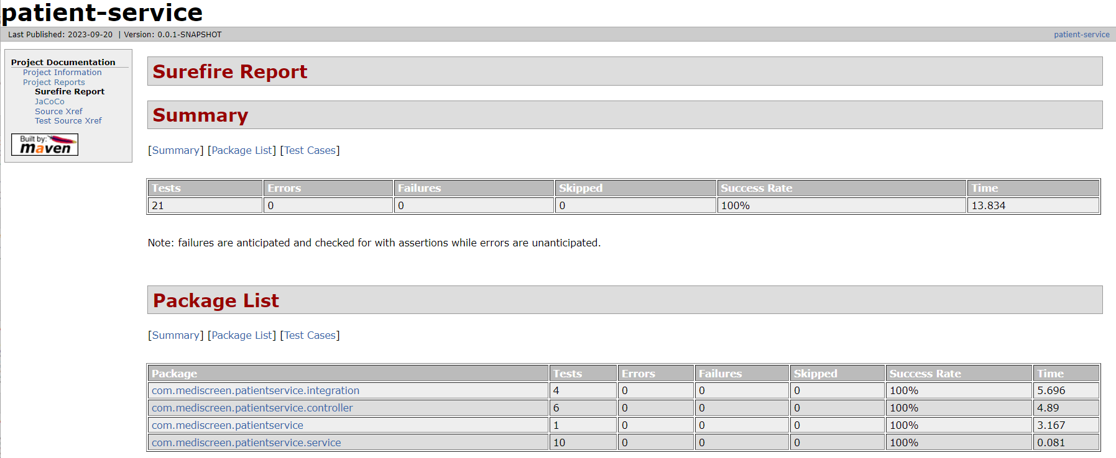
Surefire Report

Slide 7
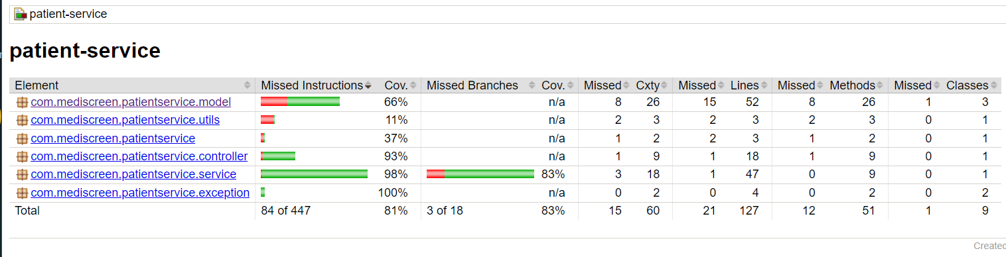
Jacoco Coverage Report

Slide 8
Requirements/Features
Sprint 2.
This sprint will be focused on creating a history-service microservice that handles the unstructured notes provided by the medical providers. Each provider will have their own style of entering text. They all use the same medical terminology. There is no limit to the size of the notes a doctor may add. The code should be interfacing with a NoSQL database for the doctor's notes. Use the initial file with some of the practitioner notes for populate and test data implementation. Make sure the finished microservice is deployable in Docker. Also, need to create the REST API documentation for the current microservice.

Slide 9
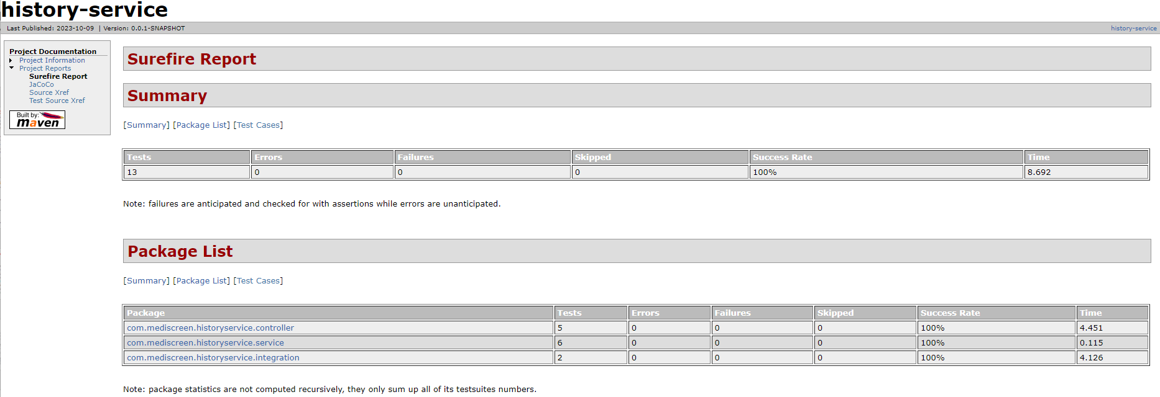
Surefire Report

Slide 10
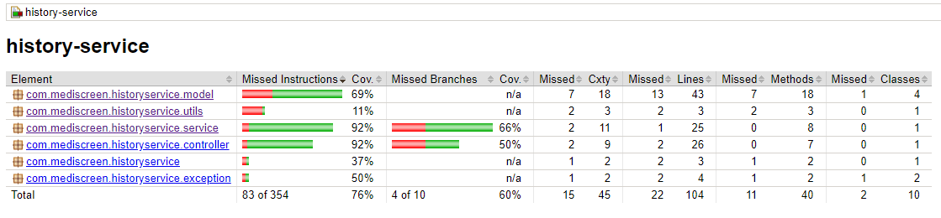
Jacoco Coverage Report

Slide 11
Requirements/Features
Sprint 3.
For this first sprint, our target is to create a report-service microservice. It will be responsible for generating the patient’s risk level for developing diabetes based on the doctor's records. The report should include the patient’s demographics, along with the risk level. Make sure the finished microservice is tested and deployable in Docker. Need to create the REST API documentation for this microservice.

Slide 12
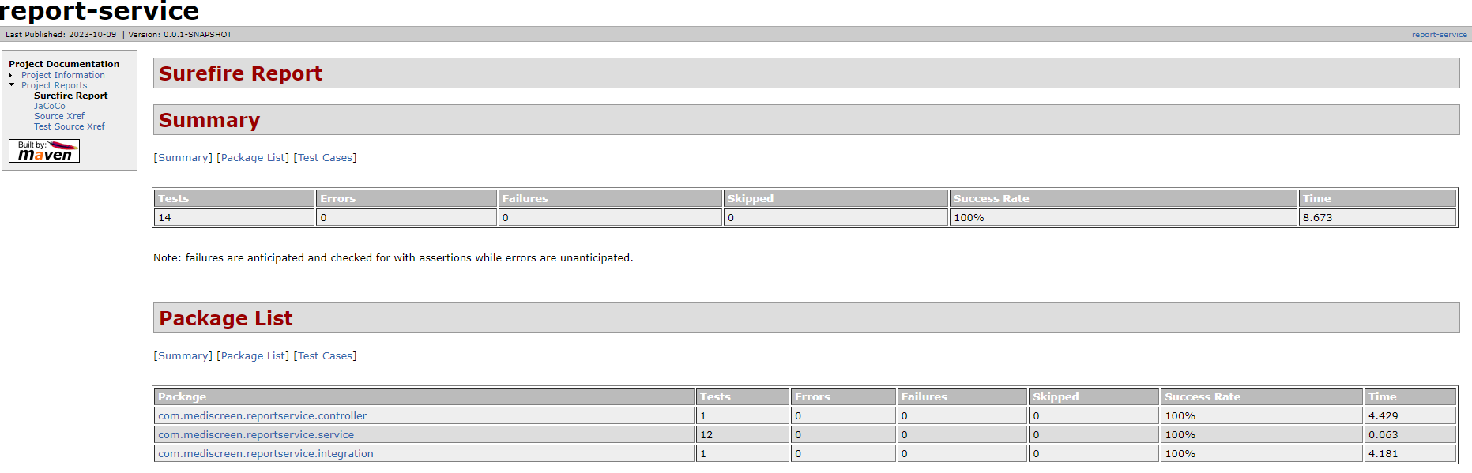
Surefire Report

Slide 13
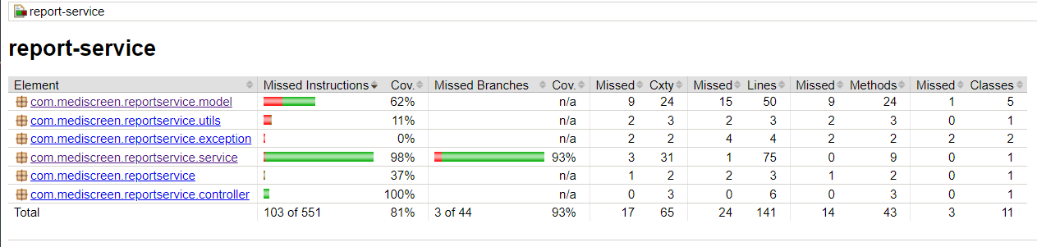
Jacoco Coverage Report

Slide 14
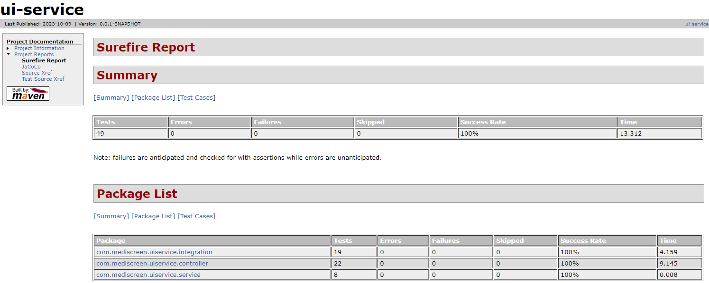
Surefire Report

Slide 15
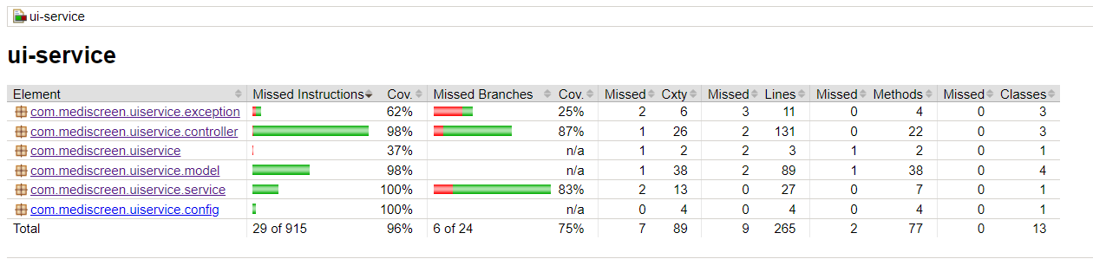
Jacoco Coverage Report

